Slide 1
BRITISH VALUES

Slide 2
On 27th November 2014, the Department for Education published guidance on promoting British values in schools to ensure young people leave school prepared for life in modern Britain. Until recently, schools have been required to ‘respect’ these values, but as a result of changes brought in, all schools must now have a clear strategy for embedding these values and show how their work with pupils has been effective in doing so. The Department for Education has stated that there is a need “to create and enforce a clear and rigorous expectation on all schools to promote the fundamental British values of democracy, the rule of law, individual liberty and mutual respect and tolerance of those with different faiths and beliefs.”

Slide 3
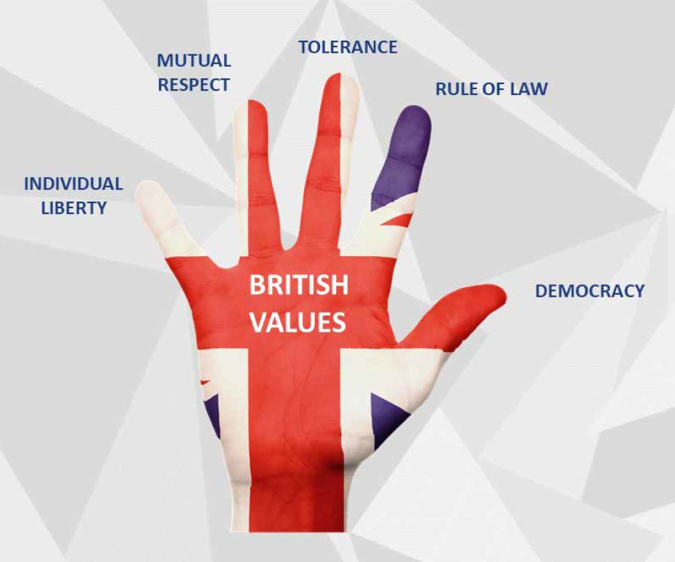
A recommended way to teach the British values to children is through the use of the ‘hand image’. We introduce the concept of British values to the children, then focus on each value in turn.

Slide 4
Democracy The thumb represents democracy. Children are taught the idea of using ‘thumbs up / thumbs down’ to vote for something they like or dislike. We reinforce democracy through:
Voting for class School Councillors and House Captains
Each class produces a Class Charter / Class Rules, showing how we respect our rights.
During competitions, the classes vote for the winners.
Pupil voice is valued and listened to by adults.
Pupil and parent questionnaires are given out.

Slide 5
Rule of Law The index finger represents the rule of law. Teach the children the idea of using ‘wagging their finger’ to tell someone what to do or not do. We reinforce the rule of law through:
A consistent behaviour policy across the school, including a tiered approach, which involves parents and children being aware of sanctions and rewards.
A home/school agreement
E-safety taught through ICT – learning how to behave in a digital world.
Children are trained as Playground Leaders
Through the university seminars, children are taught about the law and have visits from magistrates and solicitors.
Children are given the opportunity to be JPCSOs and JRSOs.

Slide 6
Tolerance The middle finger represents tolerance. Teach the children the idea of the tallest finger ‘pointing towards God.’ He teaches us to be tolerant of each other. We reinforce tolerance of those of different faiths and beliefs through:
Collective worships
Through our Values
RE curriculum
Multicultural stories
Different denominations leading Collective Worship.
Multi-lingual prayers in church.
Different creation stories and artefacts from different religions.
EAL support at parents’ meetings.
Through PSHE and Circle Time, similarities and differences are taught.
Technology is used to support different languages.
Polish club.
Visit to mosques.
Encouraging children from different backgrounds to talk about their traditions.

Slide 7
Respect The ring finger represents respect. Teach the children the idea of marriage or a relationship – we respect people we love or care about. We reinforce mutual respect through:
Values throughout the year.
Collective Worship
Comments following school trips.
Parent workshops.
Approachable staff.
Parent relationships.
Anti-bullying week.
PSHEE and RE curriculum.
Fundraising for charities carried out throughout the year.
Open-door policy to all.
Parent and pupil consultation evenings.
Remembrance services and celebrating mothers’ and fathers’ day.

Slide 8
Liberty The little finger represents liberty. Teach the children the idea of the little finger being ‘lil’ ole me’ – the freedom to be who they want to be. We reinforce individual liberty through:
Responsibility for own belongings
Homework
Key Stage productions
Christmas and Easter services
Choosing their own seminars, after-school clubs and lunchtime clubs.
Team captain roles on Sports Day.
In EYFS – child-initiated learning.
Classroom monitors, lunchtime helpers and
librarians.
Working partners and challenges

